Slide 1
PROYEK PERANGKAT LUNAK 04. Perencanaan Proyek
Doni Abdul Fatah
github.com/doniaft
Universitas Trunojoyo Madura

Slide 2
Pokok Bahasan
01. Pengantar Manajemen Proyek Perangkat Lunak
02. Siklus hidup Proyek
05. Analisa Proyek
03. Organisasi Proyek
04. Perencanaan Proyek
07. Penentuan Proyek
06. Desain Proyek
08. Manajemen Waktu Proyek
10. Manajemen SDM Proyek
11. Manajemen Risiko Proyek
09. Manajemen Biaya Proyek
12. Monitoring & Penutupan Proyek
13. UAS

Slide 3
01. PPL
Perencanaan Proyek
Kontrak Perkuliahan

Slide 4
2) Siklus hidup Proyek

Slide 5
Proyek Siklus hidup PPL
Analisa kebutuhan
Spesifikasi
Disain
Coding
Verifikasi dan validasi
Implementasi / Instalasi
Maintenance dan support

Slide 6
1) What is Software

Slide 7
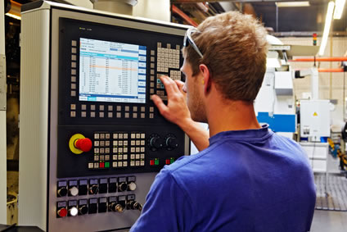

Software Hidup Kita!
Hampir semua peralatan elektronik digerakkan oleh software!
Mobil, pesawat terbang, kapal laut, …
Telepon, bangunan, kota, …
Semua disiplin ilmu menggunakan software!
Teknik dan sains (teknik sipil, teknik mesin, teknik geologi, …)
Kedokteran, farmasi, …
Hardware tidak berfungsi tanpa software di dalamnya

Slide 8
5 Best Jobs in the World
Software Engineer:
$80,500 Average Pay and 46% 10 Year Growth
College Professor:
$81,500 Average Pay and 31% 10 Year Growth
Financial Adviser:
$122,500 Average Pay and 26% 10 Year Growth
Human Resources Manager:
$73,500 Average Pay and 23% 10 Year Growth
Physician Assistant:
$75,000 Average Pay and 50% 10 Year Growth

Slide 9
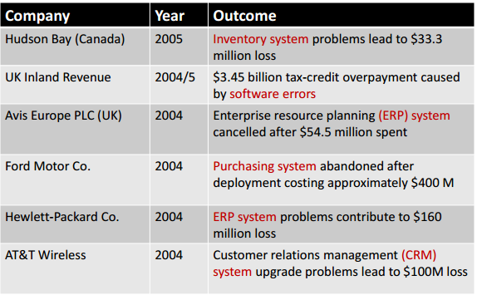
Size Berbanding Lurus dengan Kegagalan

Slide 10
The Definition of Software
Computer programs, procedures, and possibly associated documentation and data pertaining to the operation of a computer system (IEEE, 1991) (ISO, 1997) (ISO/IEC 9000-3)
(1) Instructions (computer programs) that when executed provide desired features, function, and performance (2) Data structures that enable the programs to adequately manipulate information, and (3) Descriptive information in both hard copy and virtual forms that describes the operation and use of the programs (Pressman, 2014)
Computer programs and associated documentation (Sommerville, 2015)

Slide 11
Jenis Software
Market
Domain
Lisensi

Slide 12
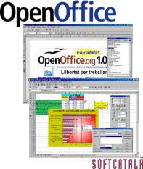
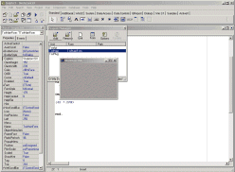
Jenis Software (Market)
Software Generik
Perangkat lunak standar yang diproduksi oleh perusahaan pengembang dan dijual pada pasar terbuka ke siapapun yang bisa membelinya (Shrink-wrapped)
Software Pesanan
Perangkat lunak yang dikembangkan khusus dan disesuaikan dengan kebutuhan pelanggan
(Sommerville, 2015)

Slide 13
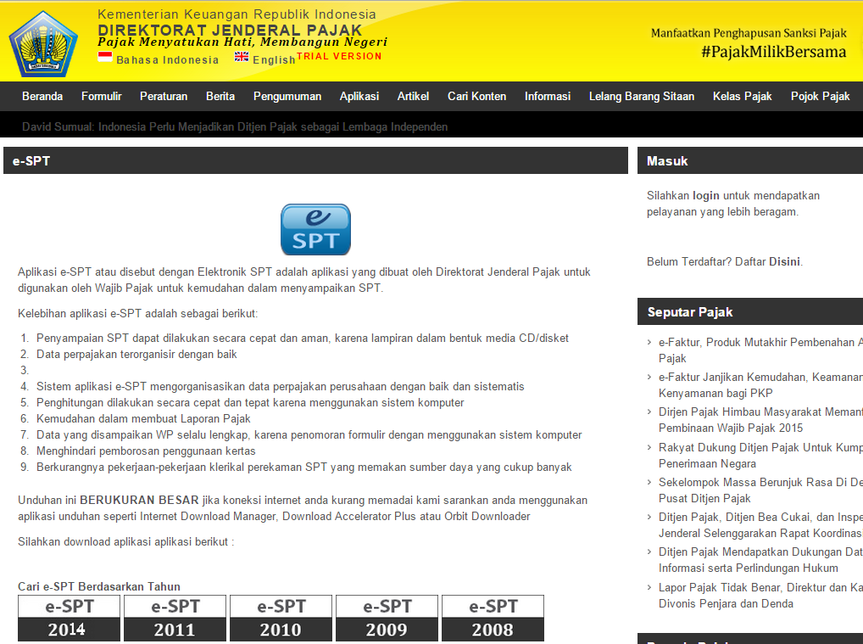

Slide 14
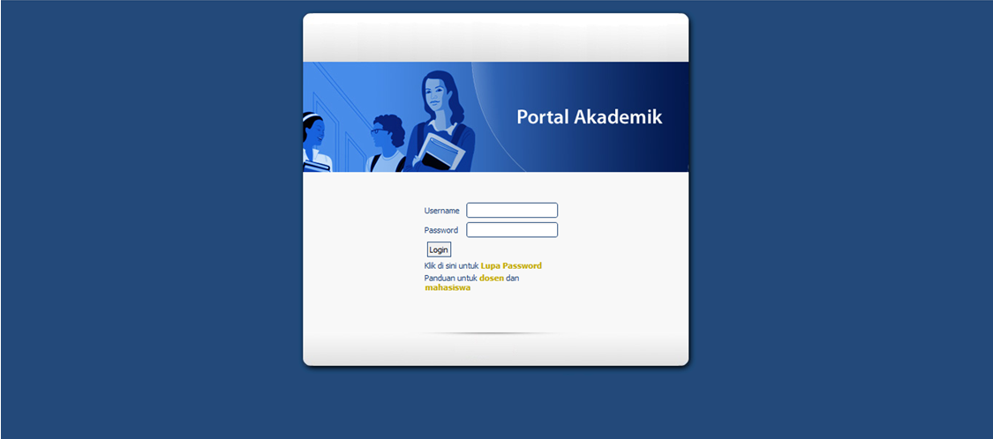
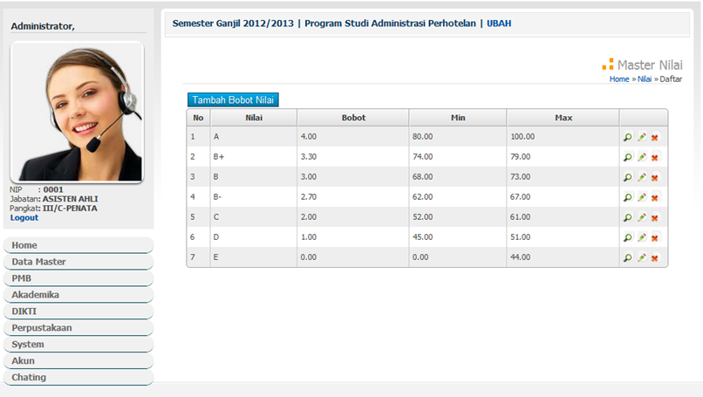
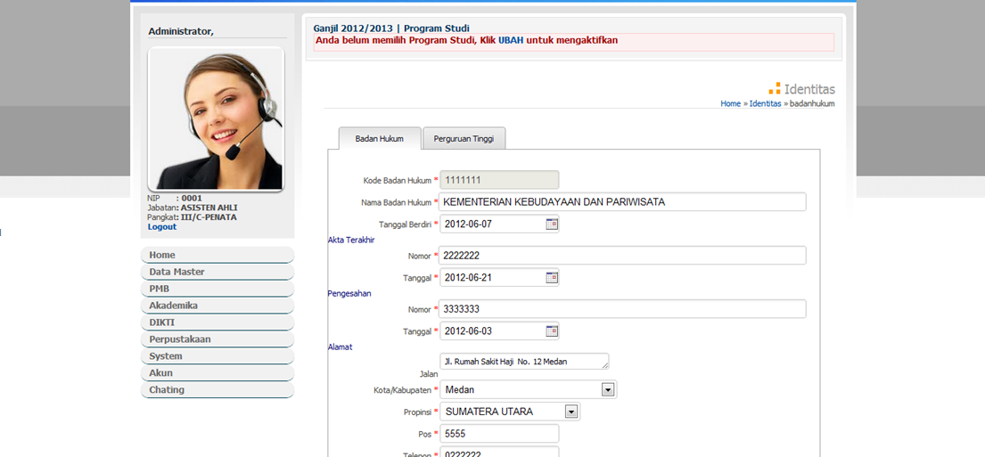

Slide 15
Jenis Software (Domain)
System software
Application software
Engineering/scientific software
Embedded software
Product line software
Web applications
Artificial intelligence software
(Pressman, 2014)

Slide 16
System Software
System software is a collection of programs written to service other programs
It is characterized by heavy interaction with computer hardware; heavy usage by multiple users; concurrent operation that requires scheduling, resource sharing, and sophisticated process management; complex data structures; and multiple external interfaces
Ex. Compilers, operating system, drivers etc.

Slide 17
Application Software
Application software consists of standalone programs that solve a specific business need
Application software is used to control the business function in real-time.

Slide 18
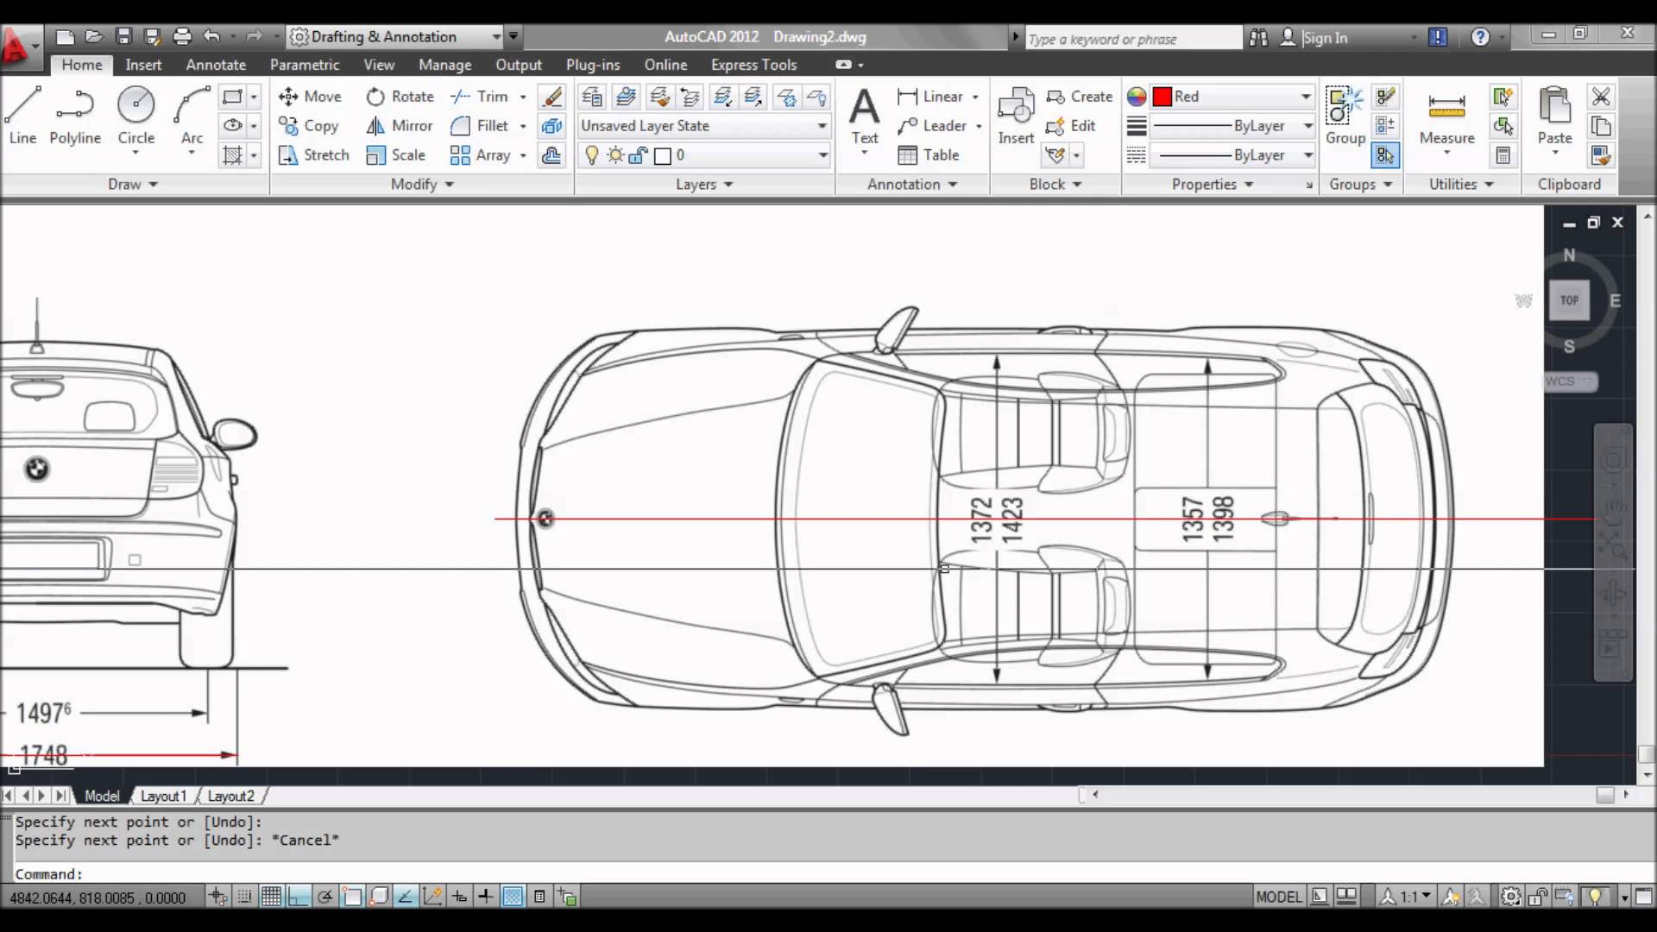
Engineering /Scientific software
Characterized by "number crunching" algorithms
Applications range from astronomy to volcano logy, from automotive stress analysis to space shuttle orbital dynamics, and from molecular biology to automated manufacturing
Ex. Computer Aided Design (CAD), system stimulation etc.

Slide 19
Embedded Software
It resides in read-only memory and is used to control products and systems
Embedded software can perform limited and esoteric functions
Ex. Elevator, Air Conditioner, keypad control for a microwave oven

Slide 20
Product Line Software
Designed to provide a specific capability for use by many different customers, product line software can focus on a limited and esoteric marketplace
Ex. Word processing, spreadsheet, CG, multimedia, etc.

Slide 21
Web Applications
Web apps can be little more than a set of linked hypertext files
It evolving into sophisticated computing environments that not only provide standalone features, functions but also integrated with corporate database and business applications

Slide 22
Artificial Intelligence Software
AI software makes use of non-numerical algorithms to solve complex problems that are not amenable to computation or straightforward analysis
Ex. Robotics, expert system, game playing, etc.

Slide 23
Jenis Software (Lisensi)
Open Source Software | Proprietary Software
Linux, OpenOffice, GIMP | MS Windows, MS Office 2013, Adobe Photoshop
Purchased with its source code | Purchased without its source code
Users can get for free of charge | Users must pay to get
Users can modify the software | Users cannot modify the software
Users can install software freely into any computer | Users must have a license from vendor before install into computer
No one is responsible to the software | Fully support from vendor if anything happened to the software

Slide 24
Open Source Software
Software yang source codenya terbuka dan didistribusikan dalam suatu format lisensi yang memungkinkan pihak lain secara bebas memperbanyak dan memodifikasi source code didalamnya
Hak cipta tetap ada, tapi lisensi memungkinkan orang lain bebas untuk menggunakan dan memodifikasi software tersebut
Jenis lisensi open source software:
GNU General Public License (GPL)
Apache License
BSD license
MIT License
Mozilla Public License

Slide 25
Proprietary Software
Software yang source codenya tertutup dan didistribusikan dengan suatu format lisensi yang membatasi pihak lain untuk menggunakan, memperbanyak dan memodifikasi
Lisensi proprietary software memungkinkan orang lain menggunakan software yang kita buat dengan diikuti penyerahan royalti (uang) ke pemilik hak ciptanya
Shareware dan Freeware adalah proprietary software. Free for use belum tentu free for (redistribute) atau free for modify!

Slide 26
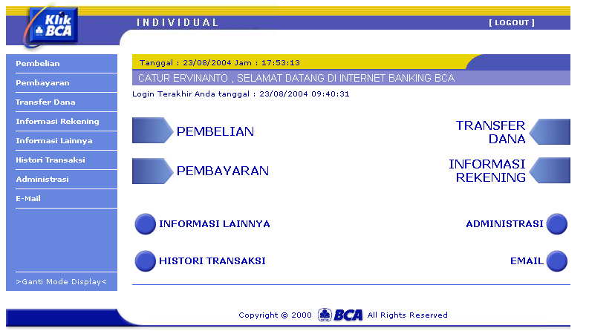
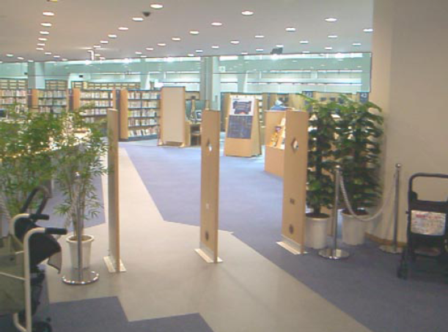
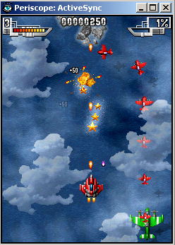
Peranan Software
Menggantikan peran manusia: Dengan otomasi terhadap suatu tugas atau proses
Memperkuat peran manusia: Dengan membantu manusia mengerjakan suatu tugas atau proses dengan lebih baik dan tertata
Restrukturisasi Peran Manusia: Dengan melakukan perubahan-perubahan thd sekumpulan tugas atau proses
Hiburan dan Permainan: Dengan menyajikan aplikasi interaktif hiburan yang semakin dekat dengan kenyataan

Slide 27
Pembahasan Khusus

Slide 28
Project Planning

Slide 29
Recap
The systems analyst is a key person analyzing the business, identifying opportunities (peluang) for improvement, and designing information systems to implement these ideas
The Systems Development Lifecycle consists of four stages: Planning, Analysis, Design, and Implementation
The major development methodologies:
Structured Design /penggambaran model sistem/modeling
Waterfall method
Parallel development
Rapid Application Development/ proses pembuaan lebih cepat/singkat,bertingkat/framwork
Phased Development
Prototyping
Throw-away Prototyping
Agile Development / memuaskan klien proses cepat, ringan, bebas bergerak,tim work banyak
Extreme Programming (menyederhanakan SDLC)
Scrum (kekuatan kolaborasi tim)

Slide 30
System Development Life Cycle (SDLC)
siklus pengembangan sistem
berfungsi untuk menggambarkan tahapan-tahapan utama dan langkah-langkah dari setiap tahapan yang secara garis besar terbagi dalam empat kegiatan utama, yaitu initiation, analysis, design dan implementation
SDLC didefinisikan oleh Departemen Kehakiman AS proses pengembangan software yang digunakan oleh analyst system, untuk mengembangkan sebuah sistem informasi.
SDLC mencakup kebutuhan (requirement), validasi, pelatihan, kepemilikan (user ownership) sebuah sistem informasi yang diperoleh melalui investigasi, analisis, desain, implementasi, dan perawatan software.

Slide 31
Tahapan System Development Life Cycle (SDLC)
System initiation ialah perencanaan awal untuk sebuah proyek guna mendefinisikan lingkup, tujuan, jadwal dan anggaran bisnis awal yang diperlukan untuk memecahkan masalah atau kesempatan yang direpresentasikan oleh proyek.
System analysis ialah studi domain masalah bisnis untuk merekomendasikan perbaikan dan menspesifikasikan persyaratan dan prioritas bisnis untuk solusi.
System design ialah spesifikasi atau konstruksi solusi yang teknis dan berbasis komputer untuk persyaratan bisnis yang diidentifikasikan dalam analisis sistem.
System implementation ialah konstruksi, instalasi, pengujian dan pengiriman sistem ke dalam produksi (artinya operasi sehari-hari).

Slide 32
Tahapan Pengembangan Software
Planning
Design
Implementation
Analysis

Slide 33
Distribusi Cost Pengembangan Software

Slide 34
2. Project Planning
2.1 Identifying Business Value (System Request)/permintaan
2.2 Feasibility Analysis/kelayakan
2.3 Project Size Estimation/ukuran suatu project/ membandingkan
Sumber :
Romi Satria Wahono romi@romisatriawahono.net http://romisatriawahono.net/sad

Slide 35
When Do Projects Begin?
When someone sees an opportunity (kesempatan) to create business value (nilai bisnis) from using information technology
Then he or she creates a system request
Feasibility analysis (kelayakan) is used to aid in the decision (pengambilan keputusan) of whether or not to proceed with the project (layak/tidak)
Project estimation is important (penting) activity which aims (tujuan) to estimating the size of software project

Slide 36
Software Development Life Cycle (SDLC)
Planning: Why build the system?
System request, feasibility analysis (sistem permintaan, analisis kelayakan)
Analysis: Who, what, when, where will the system be?
Requirement gathering, business process modeling
Design: How will the system work?
Program design, user interface design, data design
Implementation: System construction and delivery
System construction, testing, documentation and installation

Slide 37
Planning
Identifying business value
Lower costs (biaya rendah)
Increase profits (keuntungan bertambah)
Analyze feasibility (kelayakan)
Technical Feasibility
Economic Feasibility
Organizational Feasibility
System Proposal

Slide 38
Elements of a System Request
Project Name
The name of project
Project sponsor
Primary point of contact for the project
Business need/kebutuhan
Reason (alasan) prompting the project
Business requirements/persyaratan/featurnya
Business capabilities the system will need to have (kemanpuan sistem)
Business value/nilai tambah
Benefits the organization can expect from the project (manfaat)
Special issues
Anything else that should be considered(hal2 yg jadi pertimbangan)
Budget constraints, deadline, Legal requirements

Slide 39
Business Need/Kebutuhan Bisnis
Describes why the system should be built (kenapa sistem dibangun)
Why the project should be funded/ (kenapa sistem didanai)
Should be clear and concise (jelas & Ringkas)
Probably not completely defined

Slide 40
Business Requirements / Mau nya apa
What the system will do (sistem bisa apa?)
High level explanation to the approval committee
Tell about the features and capabilities
Can be replaced by Use Case Diagram

Slide 41
Business Value
Tangible value /nilai yang dapat di ukur
A quantifiable value
E.g.: 2 % reduction in operating cost
Intangible value/nilai tidak berwujud
Intuitive believe why the system will help the company (membantu perusahaan)
E.g.: improved customer service, a better competitive position

Slide 42
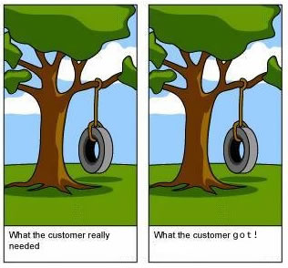
Sofware Quality
Software quality is (IEEE, 1991):
The degree (sejauh mana) to which a system, component, or process meets specified requirements
The degree to which a system, component, or process meets customer or user needs or expectations
Software quality measures how well software is designed (quality of design), and how well the software conforms to that design (quality of conformance) (Seberapa baik perangkat lunak dirancang dan sesuai desain/kualitas) (Pressman, 2014)
Quality means (sesuai) conformance to requirements (Crosby, 1979)

Slide 43
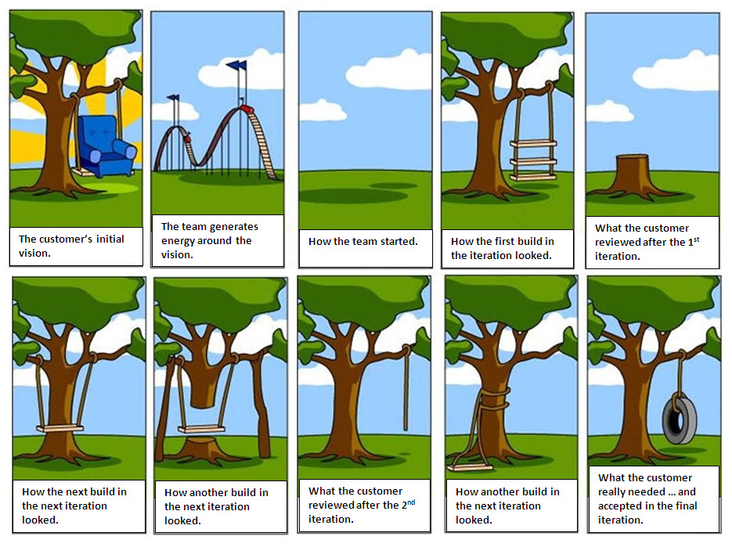

Slide 44
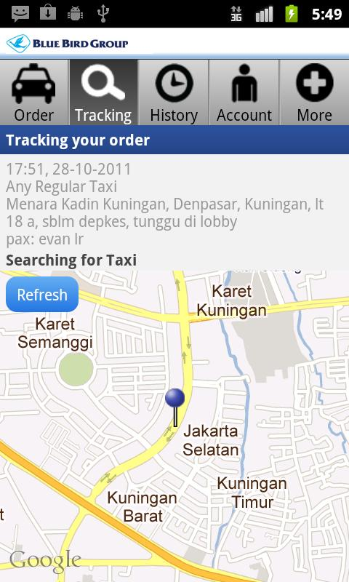
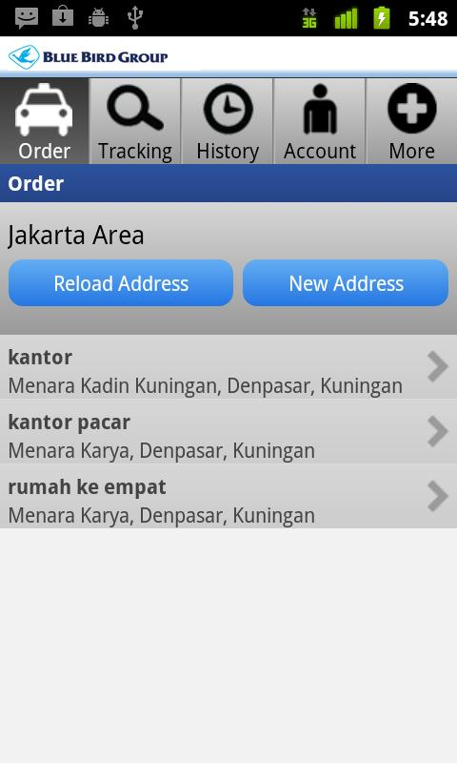
Software untuk Pesan Taxi

Slide 45
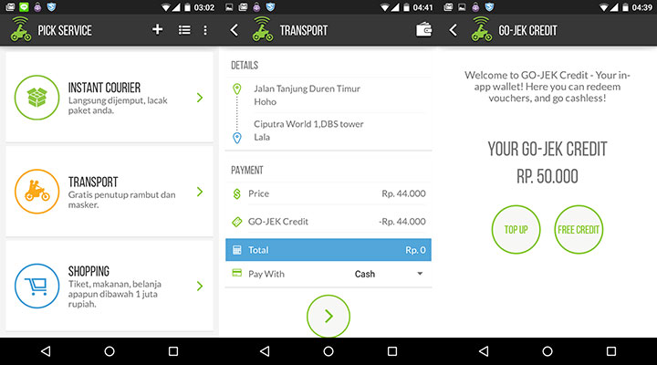
Software untuk Pesan Ojek (Go-Jek)

Slide 46

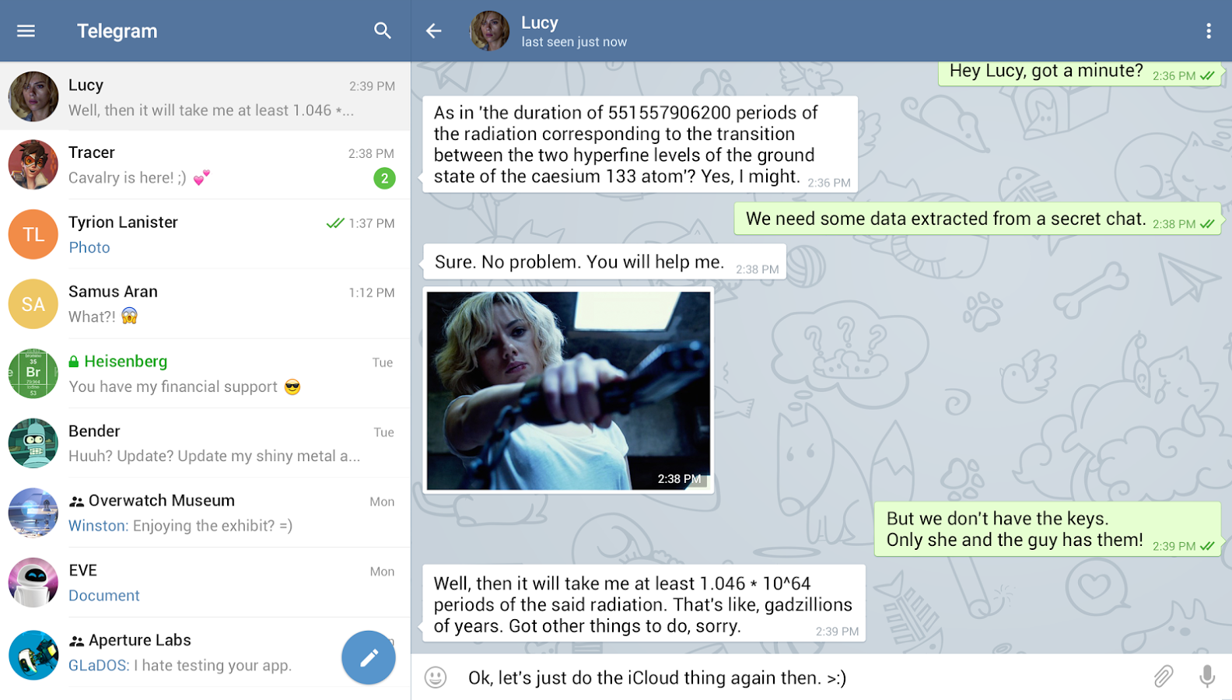

Slide 47
1. Planning – System Request
Elemen | Deskripsi | Contoh
Business Need Kebutuhan Bisnis | The business-related reason for initiating the software development project Alasan memulai proyek | Increase sales Improve market share Improve access to information Improve customer service Decrease product defects (Kurangi cacat produk) Streamline (Merampingkan) supply acquisition processes
Business Requirements Persyaratan Bisnis | The business capabilities that software will provide Kemampuan disediakan oleh perangkat lunak | Provide onIine access to information Capture customer demographic information Include product search capabilities Produce management reports Include online user support
Business Value Nilai bisnis | The benefits that the software will create for the organization Manfaat dibuat perangkat lunak | 3% increase in sales % increase in market share 10% operational cost reduction $200,000 cost savings from decreased supply costs $150,000 savings from removal of existing system

Slide 48
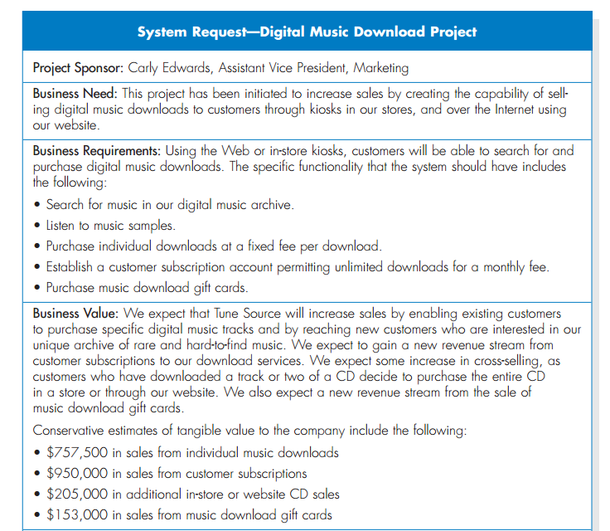

Slide 49
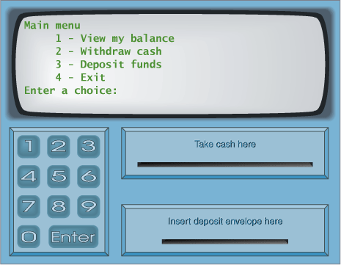
System Request – Case Study
Menu Utama
Melihat Saldo
Mentransfer Uang
Mengambil Uang
Logout
Kotak Uang
Kotak Kartu
Kotak Kuitansi

Slide 50
System Request – Online ATM System
Project Sponsor: | Margaret Mooney, Vice President of Marketing
Business Need: | Project ini dibuat dengan tujuan untuk mendapatkan pelanggan baru yang menggunakan Internet dam memberikan layanan yang lebih baik ke pelanggan yang ada melalui layanan berbasis Internet
Business Requirements:
Dengan menggunakan Online ATM System, pelanggan dapat melakukan seluruh transaksi perbankan. Fitur utama yang ada pada sistem ini adalah: Pengecekan Saldo Pengiriman Uang Transaksi Pembayaran Tagihan
Business Value:
Keuntungan Intangible: - Meningkatkan layanan ke pelanggan - Mengurangi komplen dari pelanggan Keuntungan Tangible: - $750,000 transaksi keuangan dari pelangan baru - $1,875,000 transaksi keuangan dari pelanggan lama - $50,000 pengurangan biaya telepon untuk melayani pelanggan

Slide 51
System Request: CD Selection Project
Project Sponsor: | Margaret Mooney, Vice President of Marketing
Business Needs: | This project has been initiated to reach new Internet customers and to better serve existing customers using Internet sales support
Business Requirements:
Using the Web, customers should be able to search for products and identify the brick-and-mortar stores that have them in stock. They should be able to put items on hold at a store location or place an order for items that are not carried or not in stock. The functionality that the system should have is listed below: Search through the CD Selections’ inventory of products Identify the retail stores that have the product in stock Put a product on hold at a retail store and schedule a time to pick up the product Place an order for products not currently in stock or not carried by CD Selections Receive confirmation that an order can be placed and when it will be in stock
Business Value:
Intangible Value: Improve customer satisfaction Increase brand recognition due to its Internet presence Tangible Value: Increase sales by reducing lost sales due to out-of-stock or nonstocked items and by reaching out to new customers through its Internet presence $750,000 in increased sales from new customers $1,875,000 in increased sales from existing customers Reduce customer complaints, primarily because 50 percent of all customer complaints stem from out of stocks or nonstocked items $50,000 yearly reduction in customer service calls

Slide 52
System Request: CD Selection Project
Project Sponsor: | Margaret Mooney, Vice President of Marketing
Business Needs: | This project has been initiated to reach new Internet customers and to better serve existing customers using Internet sales support.
Business Requirements:
Using the Web, customers should be able to search for products and identify the brick-and-mortar stores that have them in stock. They should be able to put items on hold at a store location or place an order for items that are not carried or not in stock. The functionality that the system should have is listed below: Search through the CD Selections’ inventory of products Identify the retail stores that have the product in stock Put a product on hold at a retail store and schedule a time to pick up the product Place an order for products not currently in stock or not carried by CD Selections Receive confirmation that an order can be placed and when it will be in stock
Business Value:
Intangible Value: CD Selections should benefit from improved customer satisfaction and increased brand recognition due to its Internet presence. Tangible Value: CD Selections will increase sales by reducing lost sales due to out-of-stock or nonstocked items and by reaching out to new customers through its Internet presence. Then the improved services will reduce customer complaints, primarily because 50 percent of all customer complaints stem from out of stocks or nonstocked items. Tangible value estimation: $750,000 in increased sales from new customers $1,875,000 in increased sales from existing customers $50,000 yearly reduction in customer service calls
Special Issues or Constraints:
The Marketing Department views this as a strategic system. This Internet system will add value to our current business model. In the future, CD Selections may want to sell products directly over the Internet. The system should be in place for the holiday shopping season next year.

Slide 53
Exercise: Membuat System Request
Lihat contoh System Request pada slide sebelumnya.
Pikirkan suatu sistem* yang saat ini dibutuhkan oleh perusahaan atau organisasi anda
Buat System Request dari sistem tersebut
Pikirkan baik-baik, keuntungan yang didapat (business value) dari penerapan system tersebut di organisasi
* System request yang anda buat akan menjadi studi kasus dari pembelajaran kita selama course berlangsung

Slide 54
2. Planning - Feasibility Analysis (Analisis Kelayakan)
Technical feasibility: Can we build it?
Bisakah kita membangunnya?
Economic feasibility: Should we build it?
Haruskah kita membangunnya?
Organizational feasibility: If we build it, will they come?
Jika kita membangunnya, akankah mereka datang?

Slide 55
2. Planning - Feasibility Analysis
1 | Technical Feasibility | Familiarity with application: Less familiarity generates more risk (Kurang keakraban lebih banyak risiko) Familiarity with technology: Less familiarity generates more risk Project size: Large projects have more risk Compatibility: The harder it is to integrate the system with the company’s existing technology, the higher the risk will be (kesulitan mengintegrasikan sistem ke teknologi)
2 | Economic Feasibility | Return on Investment (ROI) Break Even Point (BEP) - titik impas jumlah pendapatan dan biaya sama atau seimbang Intangible Benefit
3 | Organizational Feasibility | Is the software project strategically aligned with the business? (Apakah proyek sesuai dg strategis bisnis)

Slide 56
Feasibility Analysis - Technical Feasibility
Familiarity with application | Knowledge of business domain Need to understand improvements Need to recognize pitfalls and bad ideas Pitfalls : kejadian yang lazim tidak disangka—karena dianggap remeh, terlupakan, atau ketidaktahuan, yang berpotensi menjadi masalah
Familiarity with technology | Is technology new to this organization? Is this a brand new technology? Extension of existing firm technologies (Perpanjangan/pengembangan teknologi perusahaan)
Project size | Number of people, time, and features
Compatibility | Systems are not built in a vacuum (ruang hampa) Needs to integrate with current systems and data

Slide 57
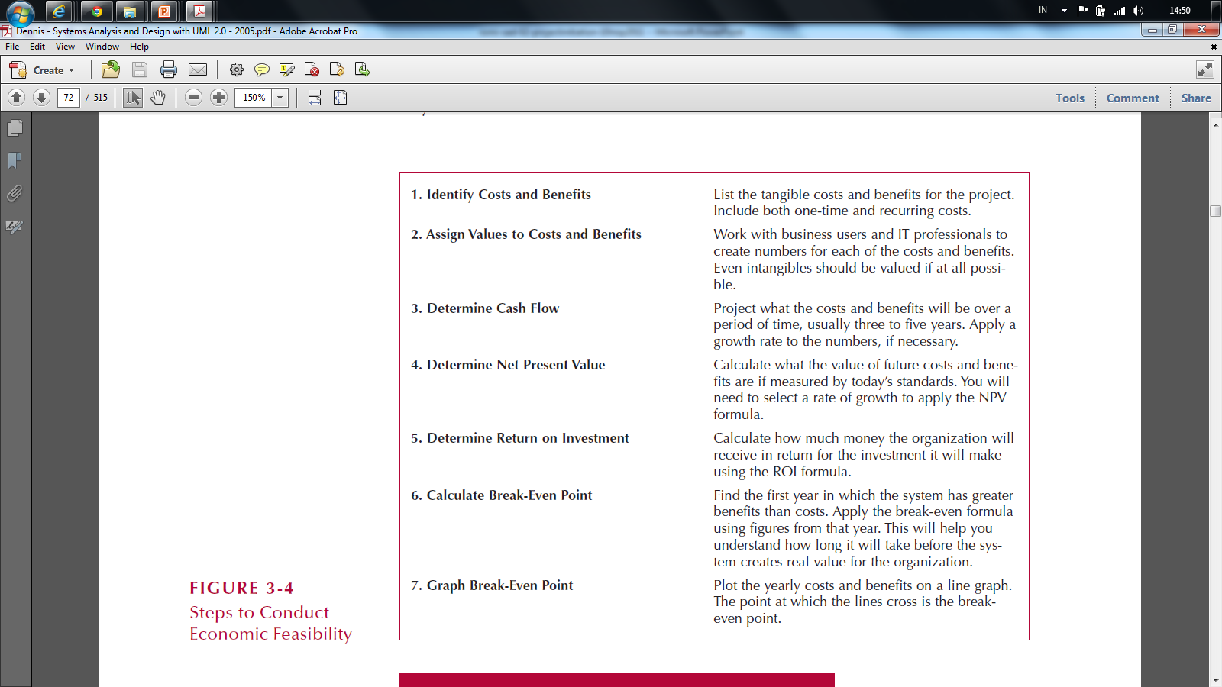
Economic Feasibility: Should We Build It?
Ex : development, operational,etc
Menetapkan biaya user,it profesional hingga biaya tak berwujud
Menentukan arus kas, biaya dan tingkat pertumbuhan 3 s.d 5 thn,/dlm angka
berapa pertumbuhan/ pendapatan yang akan datang jika patokannya saat ini
berapa uang yang akan diterima dari investasi
Menghitung BEP mulai dari awal tahun BEPnya
Grafik - Titik BEP ketika garis melintang

Slide 58
Cost - Benefit Analysis - Cash Flow
Project costs and benefits over several years (3–5)
Biaya dan manfaat proyek selama beberapa tahun (3-5)
Use normal growth rates for sales etc.
Gunakan tingkat pertumbuhan normal untuk penjualan
Total added to determine
Total ditambahkan untuk menentukan
Overall Benefits = Total Benefits – Total Costs
Manfaat Keseluruhan = Total Manfaat - Total Biaya
Higher number is better
Angka yang lebih tinggi lebih baik

Slide 59
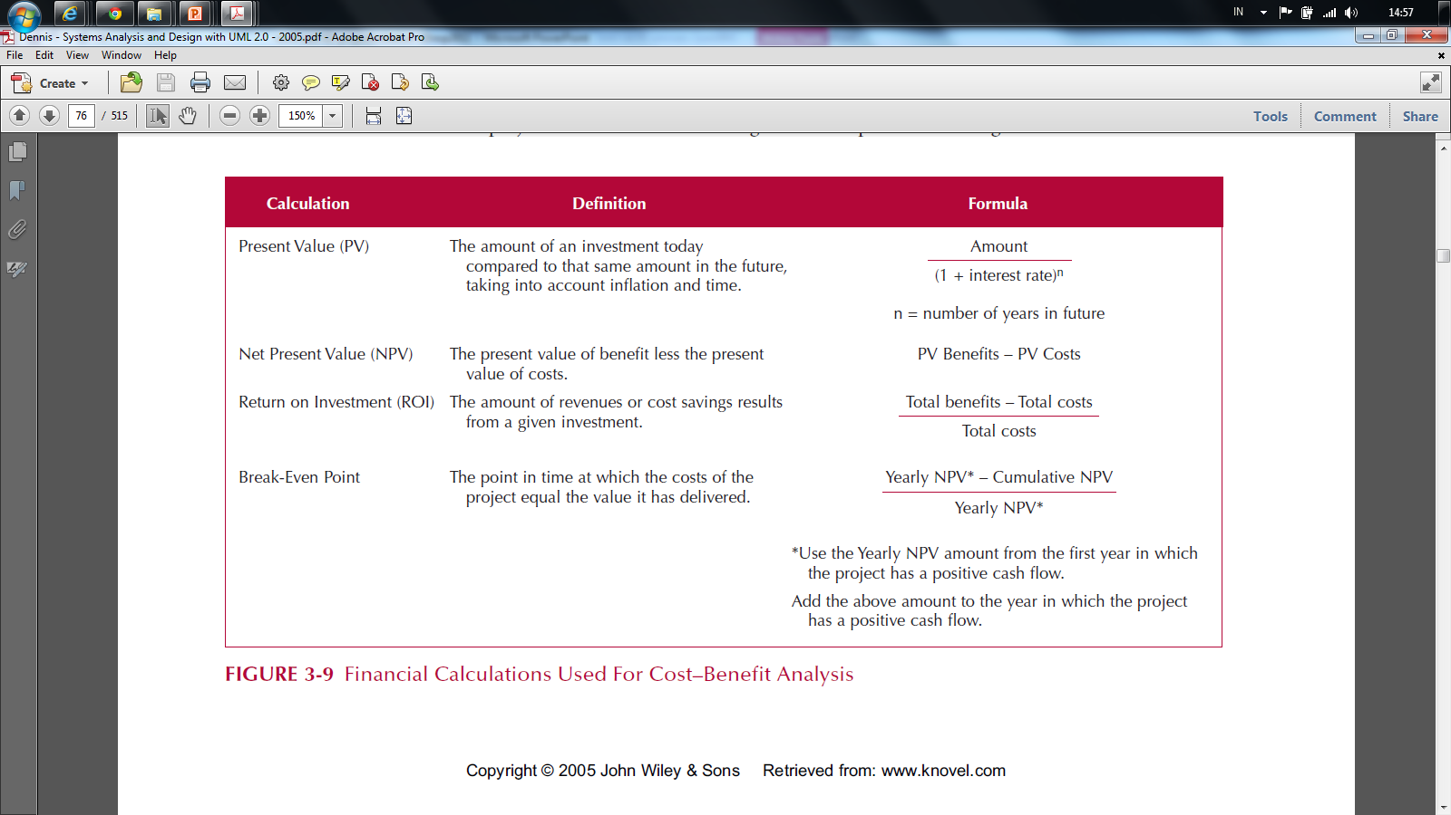
Cost-Benefit Analysis - Cash Flow

Slide 60
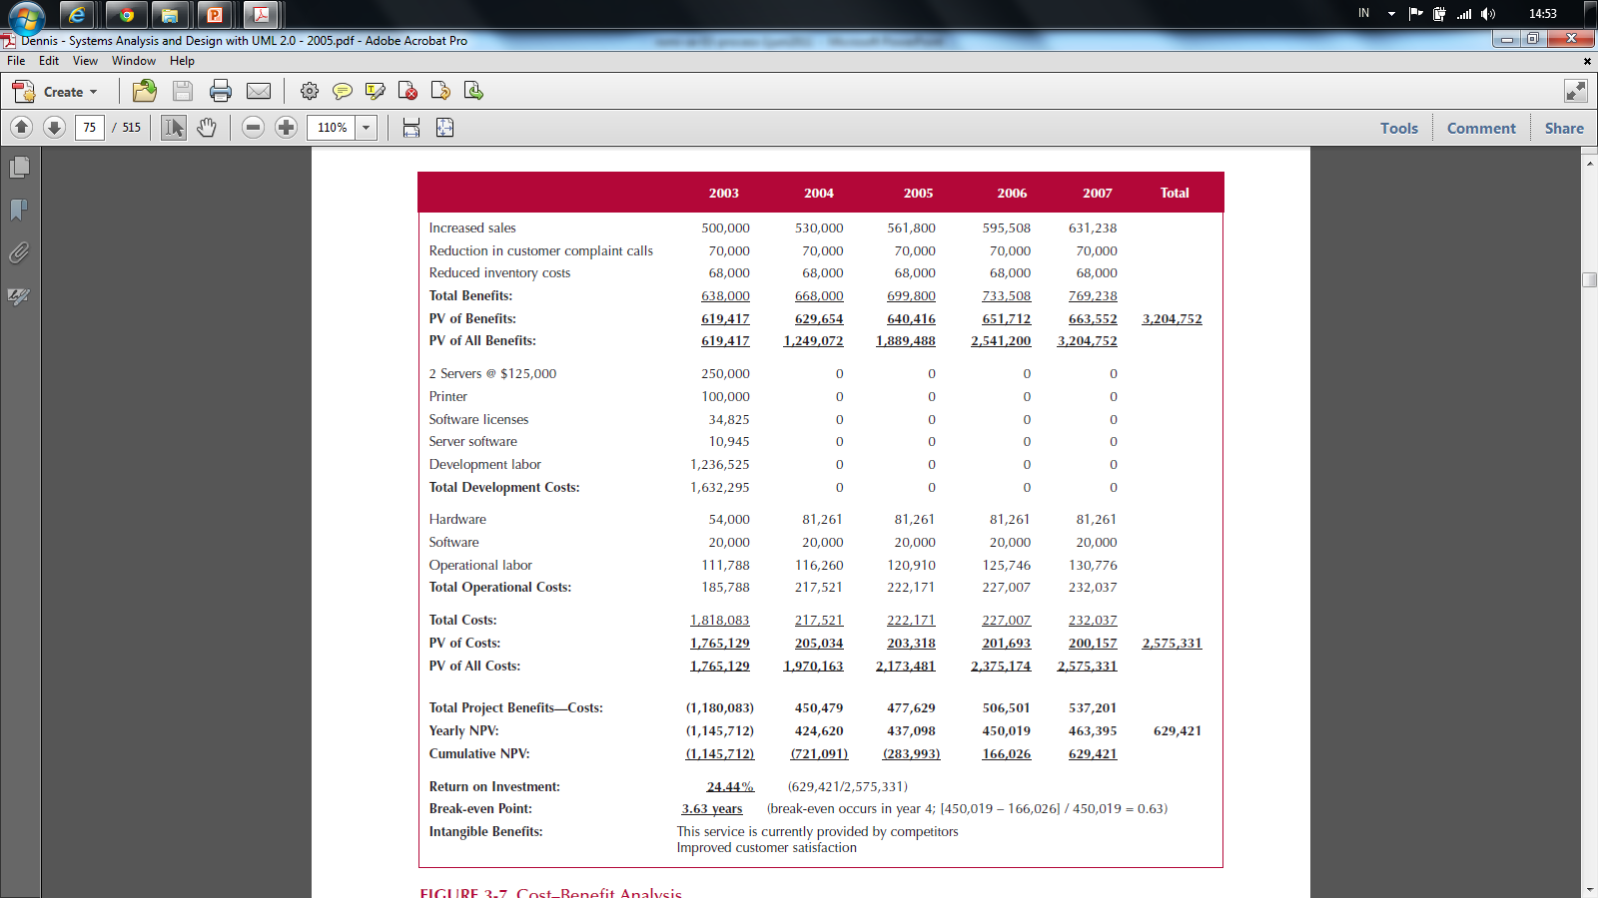
Cash Flow Plan

Slide 61
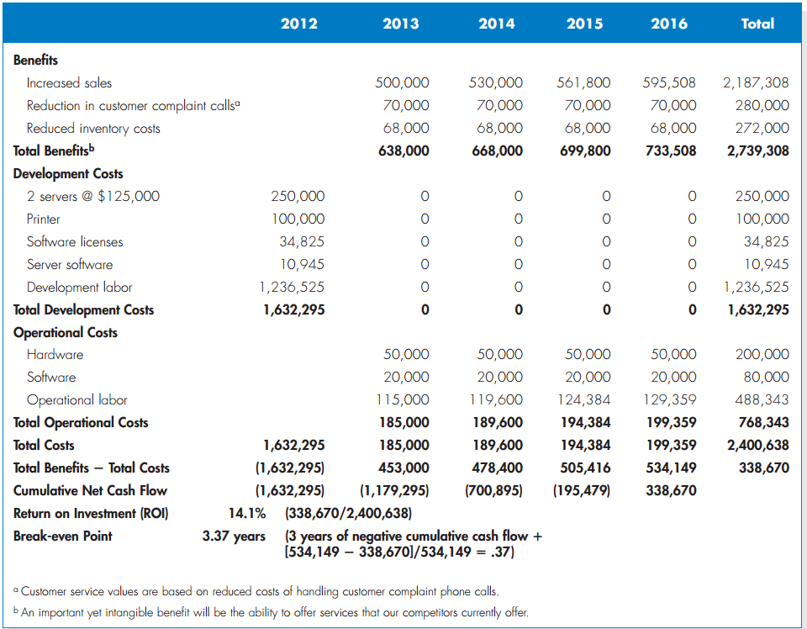

Slide 62
Present Value (PV) - Nilai sekarang
The amount of an investment today compared to the same amount n years in the future
Taking into account inflation and time
(nilai uang saat ini untuk nilai tertentu di masa yang akan datang)
PV =
Ket:
PV : nilai tahun ke 0
Amount : nilai pada akhir tahun ke n
Interest Rate : Suku bunga
n : jumlah waktu (tahun)
Amount
(1 + Interest Rate)^{n}

Slide 63
Net Present Value

Slide 64
Net Present Value (NPV) selisih Pengeluaran dan pemasukan
The present value of benefit less the present value of cost
NPV = PV Benefits – PV Costs
Manfaat NPV :
mengukur kemampuan dan peluang investasinya hingga beberapa tahun yang akan datang,
investasi tersebut akan menguntungkan bagi mereka?
Atau merugikan?
Jika memang menguntungkan, seberapa besar margin keuntungannya?
Apakah cukup worth itu untuk dijalankan?
Ataukah tidak sebanding dengan effort yang dikeluarkan?

Slide 65
NPV Calculation

Slide 66
Return on Investment (ROI) Laba Atas Investasi
The Amount of revenue or cost savings results from a given investment
ROI =
Total Benefits – Total Costs
Total Costs

Slide 67
Return on Investment (ROI) (contd-2) Manfaat ROI
Mengukur efisiensi penggunaan modal yang bekerja, efisiensi produksi, dan efisiensi penjualan.
Membandingkan efisiensi penggunaan modal perusahaan lain yang sejenis
Mengetahui perusahaannya berada di bawah, sama, atau di atas rata-rata.
Mengetahui letak kelemahan dan kekuatan perusahaan dengan perusahaan lain sejenis
Mengukur efisiensi tindakan-tindakan tiap devisi
Mengukur profitabilitas dari produk yang dihasilkan
Keperluan kontrol, maupun perencanaan

Slide 68
ROI Calculation

Slide 69
Break Even Point (BEP)
The point in time when the costs of the project equal (sama) the value it has delivered
BEP =
* Use the yearly NPV amount from the first year in which project has positive cash flow
Yearly NPV* – Cumulative NPV
Yearly* NPV

Slide 70
Break Even Point (BEP) – (contd-2)
Break Even Point digunakan untuk menganalisis proyeksi sejauh mana banyaknya jumlah unit yang diproduksi berapa uang yang harus diterima untuk balik modal.
Komponen BEP :
Fixed Cost (tenaga kerja/karyawan, penyusutan alat,dll)
Variabel Cost (biaya per unit sifatnya dinamis, biaya bahan baku, biaya listrik, dll)
Selling Price (harga jual per unit barang/jasa yang telah diproduksi)

Slide 71
Break Even Point (BEP) – (contd-3)
Rumus Break Even Point
Dasar Unit
Berapa unit jumlah barang/jasa yang harus dihasilkan untuk mendapat titik impas: BEP = FC /(P-VC)
Dasar Penjualan
Berapa rupiah nilai penjualan yang harus diterima untuk mendapat titik impas:
FC/ (1 – (VC/P))* Penghitungan (1 – (VC/P))
BEP Laba /target laba
BEP – Laba = (FC + Target Laba) / (P – VC)
BEP – Pembuktian Laba
Laba : Penjualan – (FC + Total VC))

Slide 72
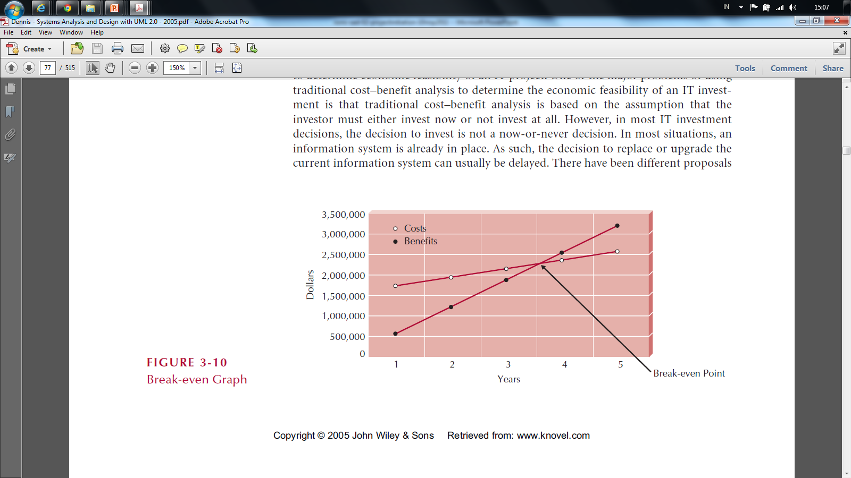
Break Even Point (BEP)

Slide 73
Cash Flow Plan

Slide 74
Feasibility Analysis - Organizational Feasibility Proses Pengukuran Kelayakan
Strategic Alignment
How well (baik/bagus/cocok/praktis) does the project match up with the business strategy?
Stakeholder analysis considers
Project champion(s)
Organizational management
System users
Anybody affected by the change

Slide 75
Stakeholder Analysis Considers
Project champion(s)
High-level non-IS executive
Shepherds project to completion
It's good to have more than one
Organizational management
Need this support to sell system to organization
System users
In the loop so end system meets needs (Memenuhi kebutuhan)

Slide 76
Feasibility Analysis – Case Study
Technical feasibility
Economic feasibility
Organizational feasibility

Slide 77
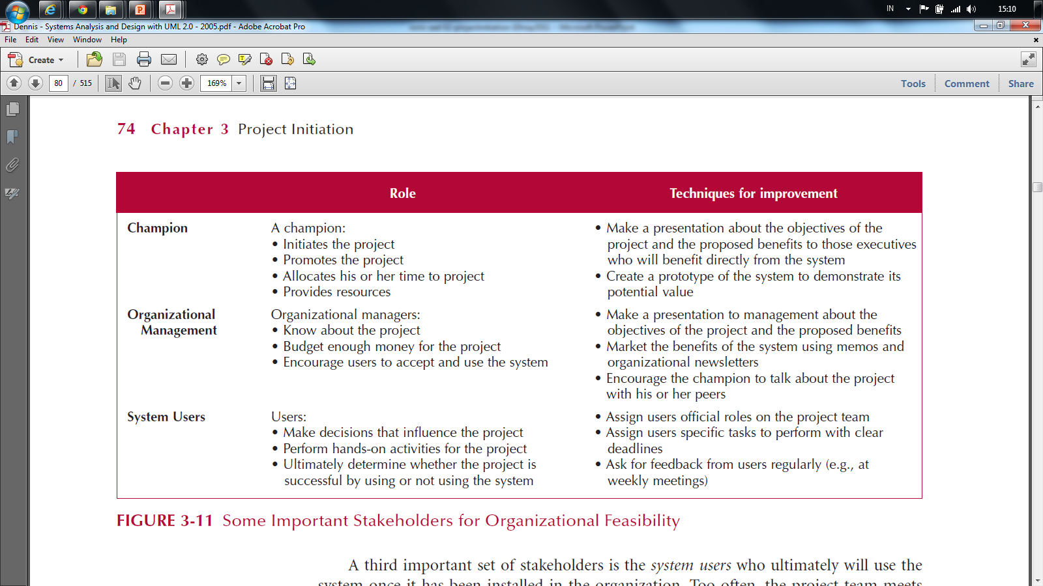
Stakeholder Analysis Considers

Slide 78
Feasibility Analysis Template
Technical Feasibility: Can We Build It?
Familiarity with Application: Less familiarity generates more risk Familiarity with Technology: Less familiarity generates more risk Project Size: Large projects have more risk Compatibility: The harder it is to integrate the system with the company’s existing technology, the higher the risk
Economic Feasibility: Should We Build It?
Return on Investment (ROI) over 3 years Break-even Point (BEP) Total benefit after 3 years
Organizational Feasibility: If We Build It, Will They Come?
Project champion(s) Senior management Users Other stakeholders Is the project strategically aligned with the business? proyek selaras secara strategis dengan bisnis?

Slide 79
CD Selection Internet Order Feasibility Analysis Executive Summary
Margaret Mooney and Alec Adams created the following feasibility analysis for the CD Selections Internet Order System Project. The System Proposal is attached, along with the detailed feasibility study
Technical Feasibility The Internet Order System is feasible technically, although there is some risk. CD Selections’ risk regarding familiarity with the application is high The Marketing Department has little experience with Internet-based marketing and sales The IT Department has strong knowledge of the company’s existing order systems; however, it has not worked with Web-enabled order systems CD Selections’ risk regarding familiarity with the technology is medium The IT Department has relied on external consultants and an Information Service Provider to develop its existing Web environment The IT Department has learned about Web technology by maintaining the corporate site Development tools and products for commercial Web application development are available in the marketplace, although the IT department has little experience with them The project size is considered medium risk The project team likely will include less than ten people Business user involvement will be required The project timeframe cannot exceed a year because of the Christmas holiday season implementation deadline, and it should be much shorter The compatibility with CD Selections’ existing technical infrastructure should be good The current Order System is a client-server system built using open standards. An interface with the Web should be possible Retail stores already place and maintain orders electronically An Internet infrastructure already is in place at retail stores and at the corporate headquarters

Slide 80
Economic Feasibility
A cost–benefit analysis was performed; see attached spreadsheet for details. A conservative approach shows that the Internet Order System has a good chance of adding to the bottom line of the company significantly. Return on Investment (ROI) over 3 years: 229 percent Break-even point (BEP): after 1.7 years Total benefit after three years: $3.5 million (adjusted for present value) Intangible Costs and Benefits Improved customer satisfaction Greater brand recognition
Organizational Feasibility
From an organizational perspective, this project has low risk. The objective of the system, which is to increase sales, is aligned well with the senior management’s goal of increasing sales for the company. The move to the Internet also aligns with Marketing’s goal to become more savvy in Internet marketing and sales. The project has a project champion, Margaret Mooney, Vice President of Marketing. Margaret is well positioned to sponsor this project and to educate the rest of the senior management team when necessary. To date, much of senior management is aware of and supports the initiative. The users of the system, Internet consumers, are expected to appreciate the benefits of CD Selections’ Web presence. And, management in the retail stores should be willing to accept the system, given the possibility of increased sales at the store level.

Slide 81
 | 2003 | 2004 | 2005 | Total
Increased sales from new customers | 0 | 750,000 | 772,500
Increased sales from existing customers | 0 | 1,875,000 | 1,931,250
Reduction in customer complaint calls | 0 | 50,000 | 50,000
Total Benefits: | 0 | 2,675,000 | 2,753,750
PV of Benefits: | 0 | 2,521,444 | 2,520,071 | 5,041,515
PV of All Benefits: | 0 | 2,521,444 | 5,041,515
Labor: Analysis, Design and Implementation | 162,000 | 0 | 0
Consultant Fees | 50,000 | 0 | 0
Office Space and Equipment | 7,000 | 0 | 0
Software and Hardware | 35,000 | 0 | 0
Total Development Costs: | 254,000 | 0 | 0
Labor: Webmaster | 85,000 | 87,550 | 90,177
Labor: Network Technician | 60,000 | 61,800 | 63,654
Labor: Computer Operations | 50,000 | 51,500 | 53,045
Labor: Business Manager | 60,000 | 61,800 | 63,654
Labor: Assistant Manager | 45,000 | 46,350 | 47,741
Labor: 3 Staff | 90,000 | 92,700 | 95,481
Software upgrades and licenses | 4,000 | 1,000 | 1,000
Hardware upgrades | 5,000 | 3,000 | 3,000
User training | 2,000 | 1,000 | 1,000
Communications charges | 20,000 | 20,000 | 20,000
Marketing expenses | 25,000 | 25,000 | 25,000
Total Operational Costs: | 446,000 | 452,700 | 464,751
Total Costs: | 700,000 | 452,700 | 464,751
PV of Costs: | 679,612 | 426,713 | 425,313 | 1,531,638
PV of all Costs: | 679,612 | 1,106,325 | 1,531,638
Total Project Costs Less Benefits: | (700,000) | 2,222,300 | 2,288,999
Yearly NPV: | (679,612) | 2,094,731 | 2,094,758 | 3,509,878
Cumulative NPV: | (679,612) | 1,415,119 | 3,509,878
Return on Investment (ROI): | 229.16% | (3,509,878/1,531,638)
Break-even Point (BEP): | 1.32 years | (BEP in Year 2 = [2,094,731 – 1,415,119] / 2,094,731 = 0.32)

Slide 82
Feasibility Analysis - Online ATM System
Margaret Mooney and Alec Adams created the following feasibility analysis for the Online ATM System Project.
1. Technical Feasibility The Online ATM System is feasible technically, although there is some risk. 1.1 Online ATM System’s risk regarding familiarity with the application is high The Marketing Department has little experience with Internet-based marketing and sales The IT Department has strong knowledge of the company’s existing ATM systems, however, it has not worked with Web-enabled ATM systems. 1.2 Online ATM System’s risk regarding familiarity with the technology is medium The IT Department has relied on external consultants to develop its existing Web env. The IT Department has learned about Web technology by maintaining the corporate site 1.3 The project size is considered medium risk The project team likely will include less than ten people Business user involvement will be required The project timeframe cannot exceed a year and it should be much shorter 1.4 The compatibility with existing technical infrastructure should be good The current ATM System is a client-server system built using open standards. An interface with the Web should be possible Retail bank already place and maintain orders electronically An Internet infrastructure already is in place at retail bank and at the corporate headquarters

Slide 83
2. Economic Feasibility
A cost–benefit analysis was performed. A conservative approach shows that the Online ATM System has a good chance of adding to the bottom line of the company significantly. Return on Investment (ROI) over 3 years: 229 percent Break-even point (BEP) occurs: after 1.7 years Total benefit after three years: $3.5 million Intangible Costs and Benefits Improved customer satisfaction Greater brand recognition
3. Organizational Feasibility
From an organizational perspective, this project has low risk. The objective of the system, which is to increase sales, is aligned well with the senior management’s goal of increasing sales for the company. The move to the Internet also aligns with Marketing’s goal to become more savvy in Internet marketing and sales. The project has a project champion, Margaret Mooney, Vice President of Marketing. Margaret is well positioned to sponsor this project and to educate the rest of the senior management team when necessary. Much of senior management is aware of and supports the initiative.

Slide 84
Exercise: Membuat Feasibility Analysis
Lihat contoh Feasibility Analysis untuk Internet Order Project
Perhatikan kembali System Request yang sebelumnya sudah kita buat
Buat Feasibility Analysis dari system yang akan kita buat tersebut

Slide 85
2.3 Project Size Estimation

Slide 86
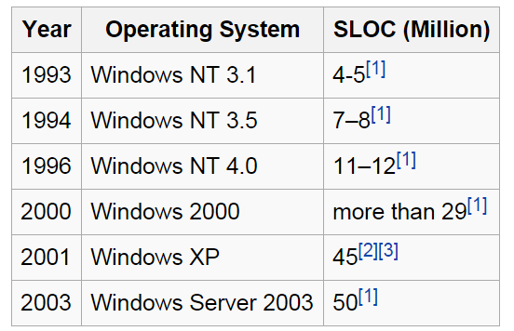

“Size” of Software Systems
Source: Wikipedia

Slide 87
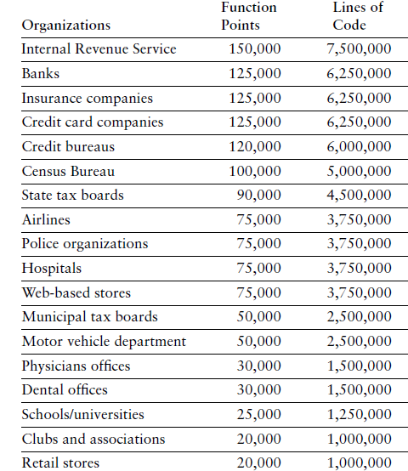
“Size” of Software Systems
Caper Jones, The Economic of Software Quality (2012)

Slide 88
Software Effort Estimation Methods
1. Simply Method
(Industry Std Percentages)
Use the time spent for planning
Estimate System Size (Function Point)
3. Use Case Point
(Gustav Karner, 1993)
Estimate System Size (Use Case Points)
Along with industry standard percentages
Estimate the overall time for the project
2. Function Point
(Allen Albrecht, 1979)
Estimate Effort Required (Person-Month)
Estimate Time Required (Month)
Estimate Effort Required (Person-Month)
Estimate Time Required (Month)

Slide 89
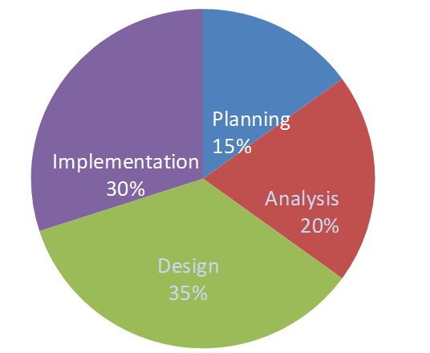
1. Simply Method

Slide 90
Time Spent for Each Phase
We are given that so

Slide 91
Estimate the Overall Time
Planning Analysis Design Implementation
Industry
Standard
For Web 15% 20% 35% 30%
Applications
Effort
Required 4 5.33 9.33 8
in Time (month)
Example: Analysis month

Slide 92
2. Function Point

Slide 93
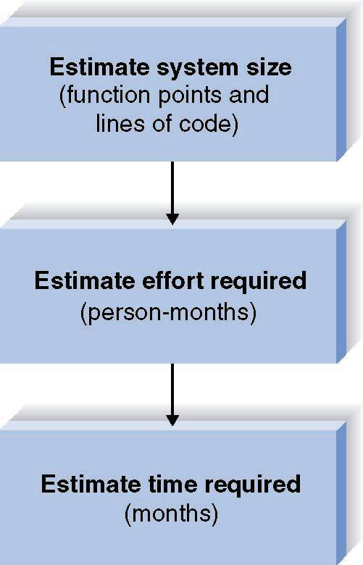
Function Point Approach
(Allen Albrecht, 1979)

Slide 94
A. Function Points Estimation -- Step One (TUFP)
Complexity
Description Low Medium High Total
Inputs __x 3 __x 4 __x 6 ____
Outputs __x 4 __x 5 __x 7 ____
Queries __x 3 __x 4 __x 6 ____
Files __x 7 __x 10 __x 15 ____
Program __x 5 __x 7 __x 10 ____
Interfaces
TOTAL UNADJUSTED FUNCTION POINTS ____

Slide 95
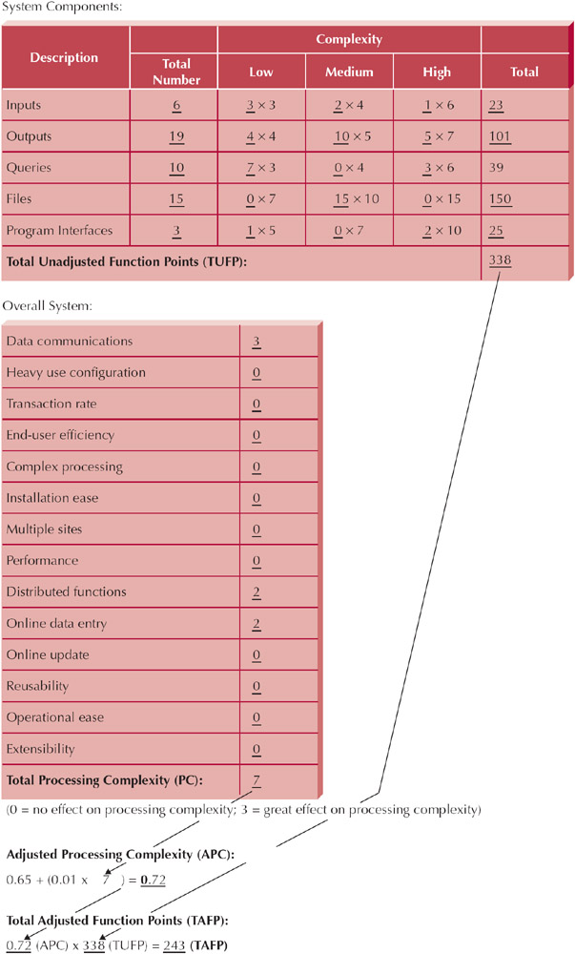
Example: CD Selection System

Slide 96
Function Points Estimation -- Step Two (Processing Complexity)
Scale of 0 to 3
Data Communications _____
Heavy Use Configuration _____
Transaction Rate _____
End-User efficiency _____
Complex Processing _____
Installation Ease _____
Multiple sites _____
Performance _____
Distributed functions _____
On-line data entry _____
On-line update _____
Reusability _____
Operational Ease _____
Extensibility _____
Processing Complexity (PC) _____

Slide 97
Example: CD Selection System

Slide 98
Function Point Estimation -- Step Three (TAFP)
Processing Complexity (PC) = 7
(From Step Two)
Adjusted Processing
Complexity (PCA) = 0.65 + (0.01 * 7 ) = 0.72
Total Adjusted
Function Points (TAFP): 338 * 0.72 = 243
(From Step One)

Slide 99
Adjusted Processing Complexity
Choose standard Adjusted Project Complexity (PCA) from the range:
0.65 Simple systems
1.0 "Normal" systems
1.35 Complex systems

Slide 100
Converting Function Points to Lines of Code
Language
LOC/Function Code Point
C
COBOL
JAVA
C++
Turbo Pascal
Visual Basic
PowerBuilder
HTML
Packages
(e.g., Access, Excel)
130
110
55
50
50
30
15
15
10-40
Source: Capers Jones, Software Productivity Research

Slide 101
Lines of Codes (LOC)
Line of Codes (LOC) = TAFP * LOC/TAFP
Example:
If TAFP = 243 Then we build the software using Java
LOC = (243 * 55) = 13365 line of codes

Slide 102
Contoh Jenis Aplikasi dan FP
Caper Jones, The Economic of Software Quality (2012)

Slide 103
B. Estimating Effort
Effort = 1.4 * thousands-of- lines-of-code
(in Person- Months)
Example:
If LOC = 13365 Then...
Effort = (1.4 * 13.365) = 18.711 Person Months

Slide 104
C. Estimating Time
Time = 3.0 * person-months^{1/3}
(in Months)
Example:
If LOC = 13365 Then...
Effort = (1.4 * 13.365) = 18.711 person-months
Time = 3.0 * 18.711 ^{1/3} = 7.9 month

Slide 105
Calculate System Size
Imagine that job hunting has been going so well that you need to develop a system to support your efforts. The system should allow you to input information about the companies with which you interview, the interviews and office visits that you have scheduled, and the offers that you receive. It should be able to produce reports, such as a company contact list, an interview schedule, and an office visit schedule, as well as produce thank-you letters to be brought into a word processor to customize. You also need the system to answer queries, such as the number of interviews by city and your average offer amount. The system will be developed using Java.

Slide 106
Hitung Size dari Sistem dengan Function Point
Sebuah perusahaan membutuhkan sistem job seeker untuk pencari kerja dan perusahaan pembuka lowongan pekerjaan
Sistem memungkinkan pencari kerja untuk menginput data curriculum vitae. Di sisi lain, perusahan pembuka lowongan kerja bisa menginput data perusahaan dan lowongan pekerjaan yang disediakan
Pencari kerja dapat melakukan pencarian (query) tentang lowongan pekerjaan apa saja yang tersedia, sedangkan pembuka lowongan kerja mencari tentang siapa saja yang sudah mendaftar di suatu lowongan pekerjaan
Sistem mampu memproduksi laporan dan statistik lengkap tentang pencari kerja, perusahaan, jenis lowongan pekerjaan dan tren lowongan kerja yang sedang populer
Laporan statistik akan disajikan dalam bentuk infografik dan juga tersedia dalam bentuk file pdf yang bisa didownload
Sistem akan dikembangkan dengan menggunakan bahasa pemrograman Java

Slide 107
Complexity
Description Low Medium High Total
Inputs __x 3 __x 4 __x 6 ____
Outputs __x 4 __x 5 __x 7 ____
Queries __x 3 __x 4 __x 6 ____
Files __x 7 __x 10 __x 15 ____
Program __x 5 __x 7 __x 10 ____
Interfaces
TOTAL UNADJUSTED FUNCTION POINTS ____

Slide 108
TUFP
 | Fungsi | Bobot | Total
Input | 3 | 3 | 9
Output | 4 | 4 | 16
Queries | 2 | 3 | 6
File | 2 | 7 | 14
Program Interface | 5 | 5 | 25
TUFP |  |  | 70

Slide 109
Processing Complexity
Data Communications 1
Heavy Use Configuration 0
Transaction Rate 0
End-User efficiency 0
Complex Processing 0
Installation Ease 0
Multiple sites 0
Performance 0
Distributed functions 0
On-line data entry 2
On-line update 2
Reusability 0
Operational Ease 1
Extensibility 0
TOTAL 6

Slide 110
TAFP
Processing Complexity (PC) = 6
Adjusted Processing
Complexity (PCA) = 0.65 + (0.01 * 6 ) = 0.71
Total Adjusted
Function Points (TAFP): 70 * 0.71 = 49.7

Slide 111
LOC → Effort (ManMonth)→ Time (Month)
LOC = 55*49.7 = 2733.5
Effort = 1.4*2.7335 = 3.83 MM
Time = 3.0 * 3.83 ^{(1/3)} = 4.6 M

Slide 112
Exercise: Membuat Project Size Estimation
Lihat contoh Project Size Estimation
Perhatikan kembali System Request, Feasibility Analysis yang sebelumnya sudah kita buat
Buat Project Size Estimation dari system yang akan kita buat tersebut

Slide 113
3) Kontrak Perkuliahan
a). Tatib Perkuliahan
b). Contact
c). Referensi

Slide 114
Tata Tertib Perkuliahan Kamis TIF6B
Masuk sesuai jadwal 7.15 WIB, Toleransi keterlambatan adalah 15 menit.
Pakaian bebas rapi berkerah, bersepatu.
Segala macam bentuk ijin ketidakhadiran diharuskan dengan alasan yang jelas
Setiap mahasiswa dilarang mencontek dalam pengerjaan tugas dan ujian, jika terjadi maka pengerjaan tugas dan ujian akan dikurangi 20% atau Gugur.
Setiap mahasiswa dilarang melakukan tindakan plagiat atas pengerjaan tugasnya, jika terjadi maka pengerjaan tugas akan dikurangi 20% atau Gugur.
Setiap mahasiswa wajib mengerjakan ujian dan tugas baik tugas mandiri ataupun berkelompok.
Wajib untuk bertutur kata yang sopan dan santun didalam kelas dan berpakaian rapih dan sopan

Slide 115
Tata Tertib Perkuliahan Jumat TIF6A
Masuk sesuai jadwal 15.15 WIB, Toleransi keterlambatan adalah 15 menit.
Pakaian bebas rapi berkerah, bersepatu.
Segala macam bentuk ijin ketidakhadiran diharuskan dengan alasan yang jelas
Setiap mahasiswa dilarang mencontek dalam pengerjaan tugas dan ujian, jika terjadi maka pengerjaan tugas dan ujian akan dikurangi 20% atau Gugur.
Setiap mahasiswa dilarang melakukan tindakan plagiat atas pengerjaan tugasnya, jika terjadi maka pengerjaan tugas akan dikurangi 20% atau Gugur.
Setiap mahasiswa wajib mengerjakan ujian dan tugas baik tugas mandiri ataupun berkelompok.
Wajib untuk bertutur kata yang sopan dan santun didalam kelas dan berpakaian rapih dan sopan

Slide 116
b) Contact

Slide 117
Contact
Bahan Kuliah : github.com/doniaft
Email : doniaft@gmail.com
WA/Telegram :
Komting PPL IF6B: Rahma Nur Laila Sari 082232916993
Komting PPL IF6A : Wahyu Akbar Wibowo 0819 1344 3901

Slide 118
c) Referensi

Slide 119
Referensi (1)
http://romisatriawahono.net
Schwalbe, K. 2006. Information Technology Project Management, Third Edition. Course Technology.
R.Duncan Wiliam, A Guide To The Project Managament Body of Knowledge PMBOK 4 [Book]. -Canada : PMBOK, 2008.
Stephen S. Bonham, IT Project Portfolio Management, ARTECH HOUSE, INC. 2005
PMI. 2008. A Guide to the Project Management Body Of Knowledge (PMBOK Guide)-Fourth Edition. Project Management Institute, Inc.
Kendall & Kendall. 2006. Analisis dan Perancangan Sistem Edisi Kelima
Jilid 1. PT. Indeks Kelompok Gramedia : Jakarta
Shelly et al. System Analysis dan Design. 2004.
Sutabri, Tata. 2005. Analisis Sistem Informasi

